Slide 1

Green Pace
Security Policy Presentation
Developer: Austin Franklin

Slide 2

OVERVIEW: DEFENSE IN DEPTH

Slide 3
THREATS MATRIX
STR30-C | STR50-CPP CTR51-CPP STR51-CPP IDS00-J MEM50-CPP EXP34-C
ERR51-CPP DCL58-CPP | DCL03-C

Slide 4
10 PRINCIPLES
Validate Input Data
Heed Compiler Warnings
Architect and Design for Security Policies
Keep It Simple
Default Deny
Adhere to the Principle of Least Privilege
Sanitize Data Sent to Other Systems
Practice Defense in Depth
Use Effective Quality Assurance Techniques
Adopt a Secure Coding Standard

Slide 5
CODING STANDARDS
Rule | Severity | Likelihood | Remediation Cost | Priority | Level
STD-001-CPP | High | Unlikely | Medium | High | 2
CTR51-CPP | High | Probable | High | P6 | L2
STR51-CPP | High | Likely | Medium | P18 | L1
IDS00-J | High | Probable | Medium | P12 | L1
MEM50-CPP | High | Likely | Medium | P18 | L1
DCL03-C | Low | Unlikely | High | P1 | L3
ERR51-CPP | Low | Probable | Medium | P4 | L3
EXP34-C | High | Likely | Medium | P18 | L1
DCL58-CPP | High | Unlikely | Medium | P6 | L2
STR30-C | Low | Likely | Low | P9 | L2

Slide 6
ENCRYPTION POLICIES
Data at Rest
Data in Flight
Data In Use

Slide 7
TRIPLE-A POLICIES
Authentication is the method used to identify the user. Typically having to enter a username and password before being granted to the user. It is used to validate that the user is who they say they are. It provides the gateway to access an application, network, or system. While also blocking users who do not have valid credentials.
Authorization is checking what permissions to grant for the user after they have authenticated to the system. For example, some administrators may have full access to make changes to databases, add new users. While other users may only have access to specific files in a system. Authorization drives user level access allowing principle of least privilege.
Accounting is logging and accountability for the system and data. It audits all valuable information in a system. This could be shown as which users last modified a file or system components. Or simply logging all transactions from users. Tracking unauthorized access can help identify access attempts.

Slide 8
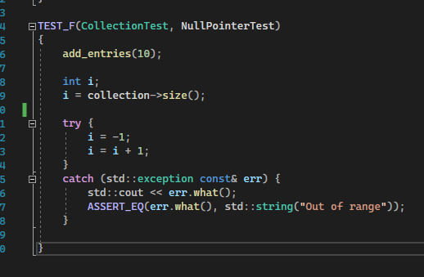
Unit Testing
CTR51-CPP - Use valid references, pointers, and iterators to reference elements of a container. This applies to all types of containers. Referencing values be done through a valid iterator, pointer, or reference. Any operation that invalidates a pointer or a reference should be treated as though it invalidates both pointers and references.

Slide 9
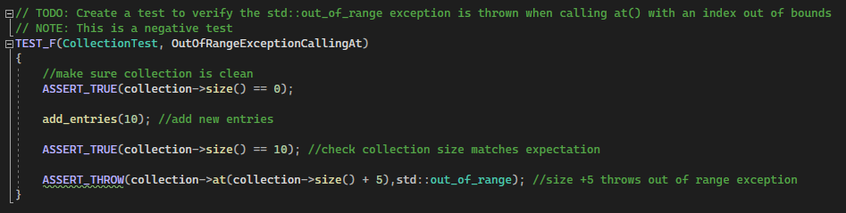
Unit Testing
STR50-CPP - Guarantee the storage for strings has sufficient space for the data and null terminator. Buffer overflows occur frequently when manipulating strings. Prevent errors through truncation or sufficient space.

Slide 10

AUTOMATION SUMMARY

Slide 11
TOOLS
DevOps pipeline or DevSecOps?
Static code checking
Code coverage
Continuous integration
Automated unit and regression testing
Astree
Monitoring and detection

Slide 12
RISKS AND BENEFITS
Cost of time from waiting
NIST study found in production stage is 15 hours compared to same bug found in coding stage
Cost of funds from waiting
IBM cost to fix bug after release 4-5 times more than if uncovered during design.
Up to 100 times more than one identified in the maintenance phase

Slide 13
RECOMMENDATIONS
Full Encryption
British Airways
Endpoint Security
Public Internet Access
Solarwinds
Target

Slide 14
CONCLUSIONS
Further revisions of this security policy
At minimum, annual revising

Slide 15
REFERENCES
Target. Hackers Used. (2022) Hackers accessed Target's network using credentials stolen from a contractor - The Verge. Retrieved April 14, 2022, from https://www.theverge.com/2014/2/5/5383338/target-hackers-accessed-retailers-network-with-stolen-contractor-credentials
Its Audience. When. (2022) SolarWinds blames intern for weak ‘solarwinds123’ password | IT PRO. Retrieved April 13, 2022, from https://www.itpro.com/security/cyber-attacks/358738/intern-blamed-for-weak-password-that-may-have-sparked-solarwinds

